Slide 1

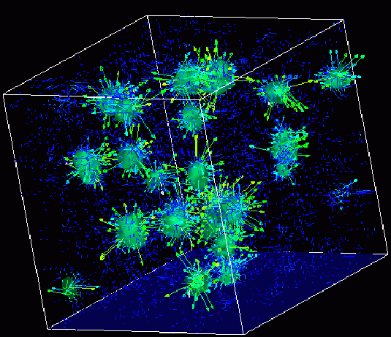

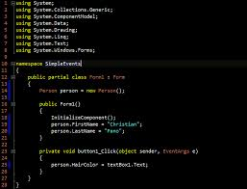
Advanced
Scientific Computing
(SciComp 201)
Session 07
Binary Arithmetic,
Logic Gates, Memory

Slide 2
Session Goals
Understand the Boolean mathematics of the three basic logic gates: NOT, AND, and OR
Learn how to draw individual logic gates and how to chain multiple logic gates together in a circuit
Incorporate multiple data input and output lines in a circuit
Develop truth tables and analyze logic circuits to calculate the output states given the input states
Understand how half-adders and full-adders operate
Appreciate how memory can be constructed from gates

Slide 3
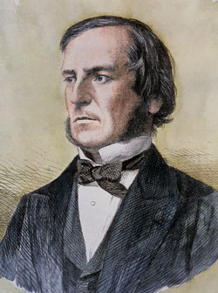
George Boole (1815 – 1864)
English mathematician
1847 published rules of symbolic logic (“Boolean Algebra”)
Only person with a data type named after him (“bool”)

Slide 4
Boolean Logic Gates
Logic Gates
Three types: NOT (inverter), AND, OR
Gates have 1 or 2 input lines, and 1 output line
Input / Output lines are either:
False, F, Cold, Low, L, 0 (Zero)
True, T, Hot, High, H, 1
Left side of a truth table is counted using Base 2 to ensure every possible permutation of input states is considered

Slide 5
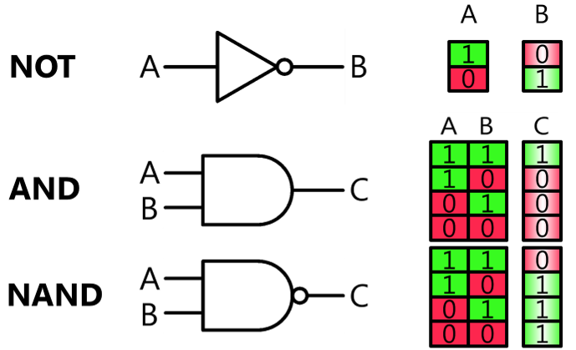
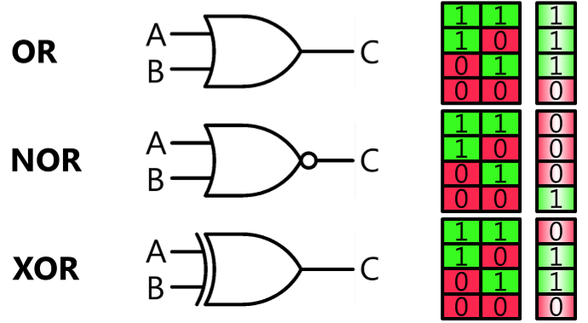
Boolean Logic Gates

Slide 6
Boolean Logic Gates
NOT (inversion) is sometimes shown as a “bar” on top
OR is a “sum” but AND is a “multiply” (modulo 2)
OR is sometimes shown as A + B
AND is sometimes shown as A • B
Circuits flow (propagate state) from “Left to Right”
Output of one gate flows into the input of the next gate
Evaluate each gate output only when each input has a value

Slide 7
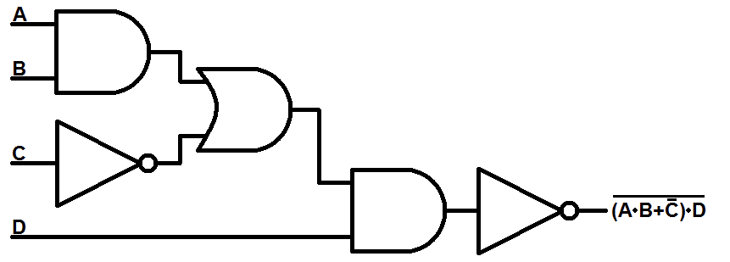
Chaining Logic Gates
AND
OR
NOT
AND
NOT

Slide 8
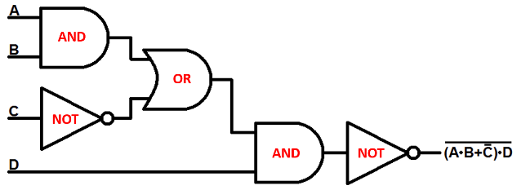
Truth Tables
1
1
1
1
1
0
1
0
1
0
0

Slide 9
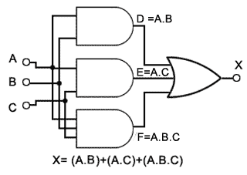
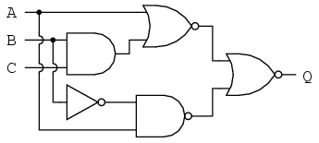
Wire Overlap vs. Intersection
Use filled circles only for electrical junction points
Carry forward current logic state of line into each branch

Slide 10
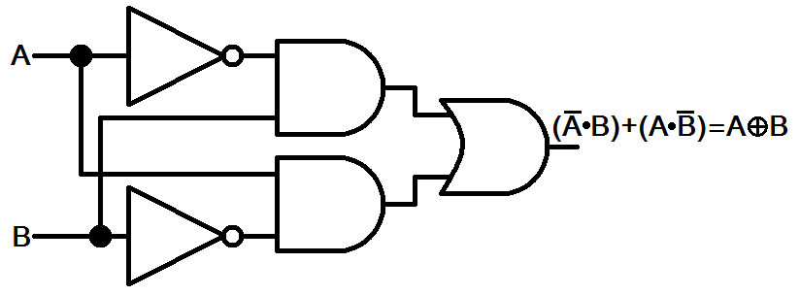
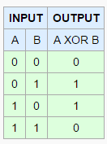
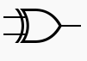
XOR Gate

Slide 11
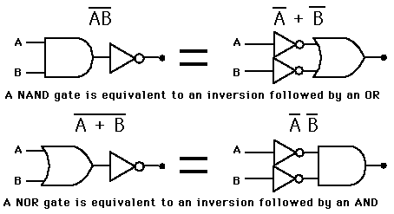
NAND and NOR Gates

Slide 12
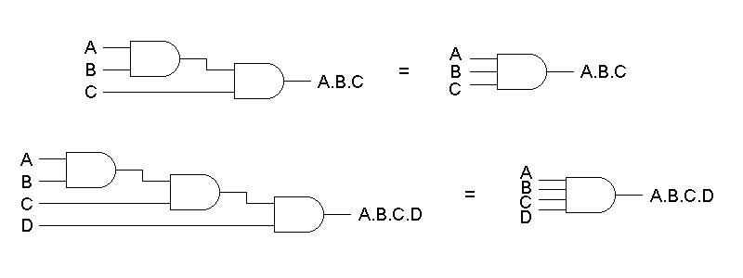
Multi-Input Gates

Slide 13
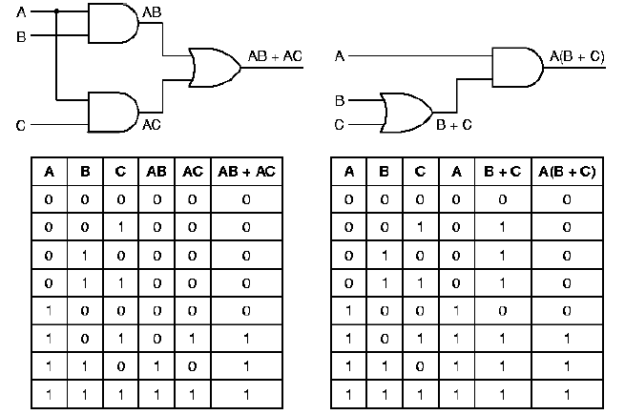
Truth Tables

Slide 14
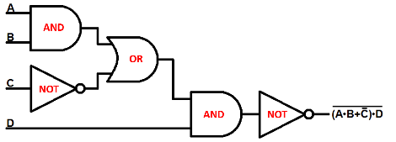
Lab 1 – Complete a Truth Table

Slide 15
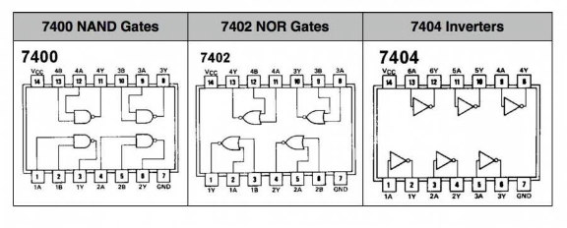
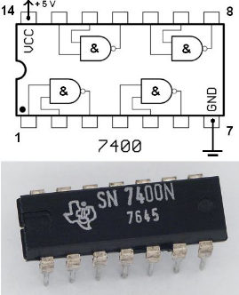
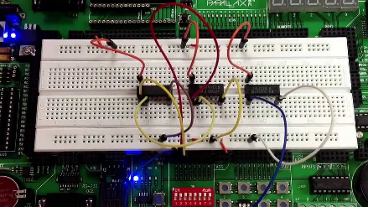
Logic Gates in the Real World

Slide 16
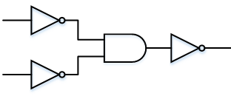
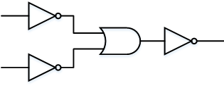
Gate Equivalence
Augustus De Morgan’s laws:
Can make an AND gate from 3 NOTs and 1 OR
Can make an OR gate from 3 NOTs and 1 AND
Simply invert both inputs and the output!
OR from AND
AND from OR

Slide 17
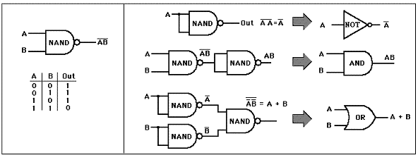
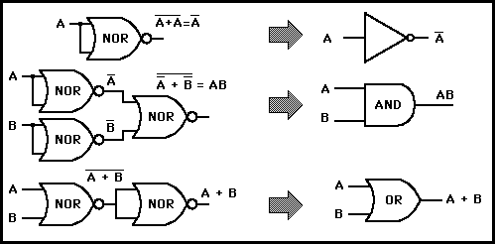
De Morgan’s Laws

Slide 18
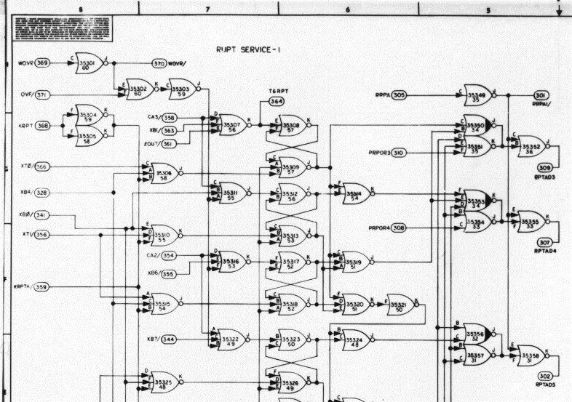
Apollo Guidance Computer

Slide 19
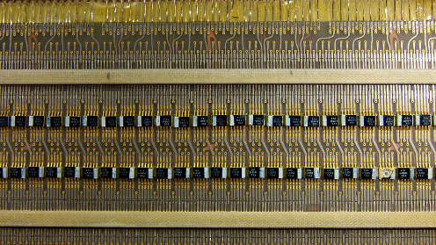

Apollo Guidance Computer

Slide 20
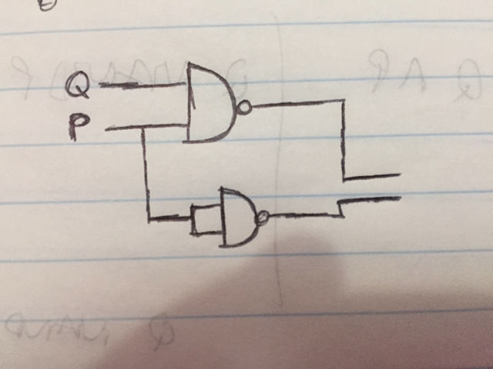
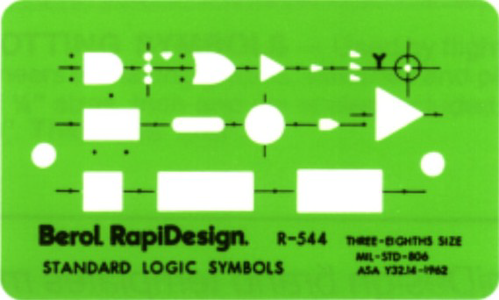
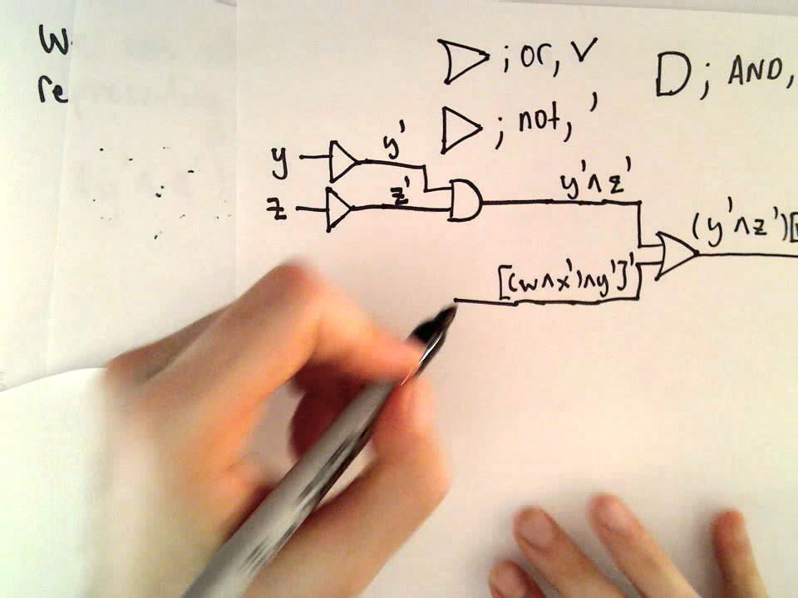

Drawing A Digital Circuit

Slide 21
Lab 2 – Majority Voting (2 of 3)
Create a truth table with input variables (A, B, C) that represent the vote (yeah or nay) of three people
Design a circuit that emits 1 as output if and only if at least 2 out of the 3 input lines are also 1
Start out by making a truth table for all 8 possible input permutations
Then use AND gates to select only those input permutations that that represent valid (1/high/true) “majority” output
Then use OR gates to gather the output of those AND gates into a single output line

Slide 22

Lab 2 – Majority Voting (2 of 3)

Slide 23
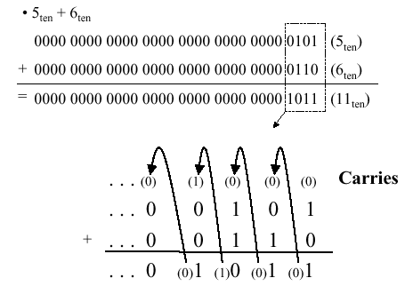
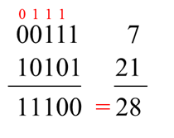
Binary Addition

Slide 24
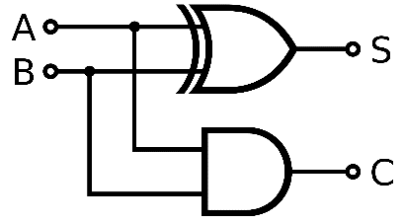
Half-Adder Circuit

Slide 25
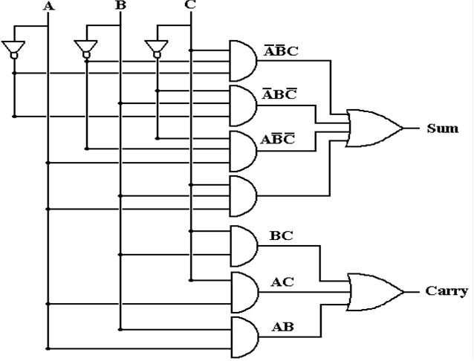
Full Adder Circuit

Slide 26
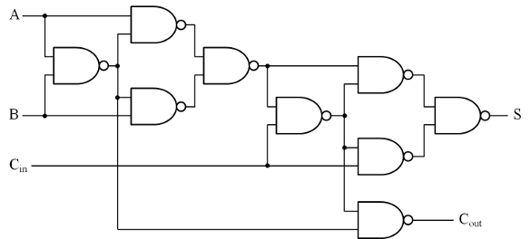
Full Adder Circuit using NAND gates

Slide 27
Lab 3
Using only 1 OR, 2 XOR, and 2 AND gates, design a FULL ADDER circuit
The circuit has 3 input lines, and 2 output lines to indicate the sum and if there needs to be a carry to the next column
Consider how FULL ADDERs can be chained to sum two 3-bit numbers

Slide 28
Full Adder Circuit using XOR gates

Slide 29
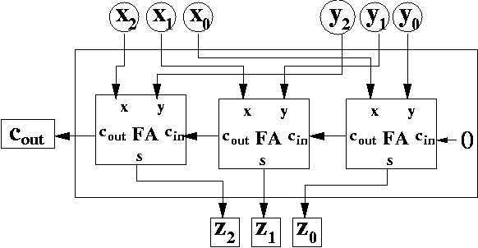
Chaining Full Adders with Ripple Carry

Slide 30
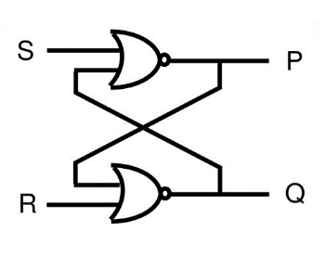
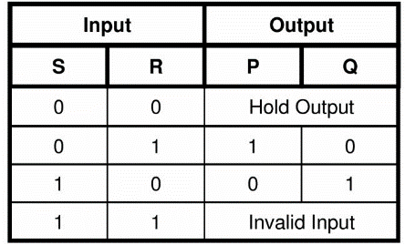
1 Bit Memory – “Set-Reset” Latch
The key was to send the output back into the input!

Slide 31
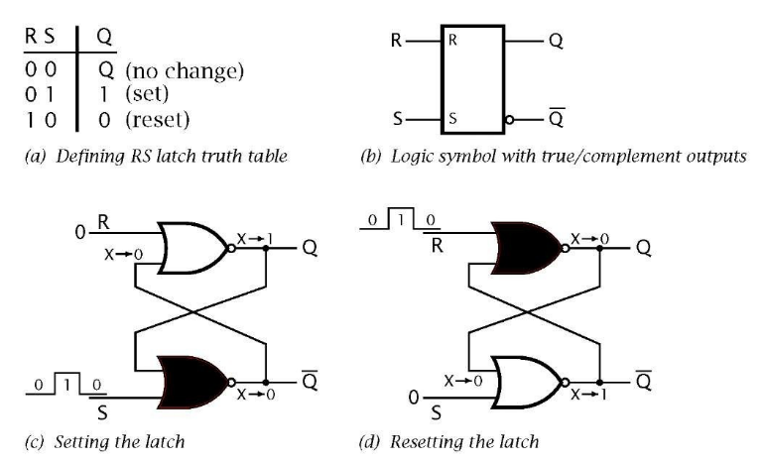
1 Bit Memory – “Set-Reset” Latch

Slide 32
1 Bit Memory – “Set-Reset” Latch

Slide 33
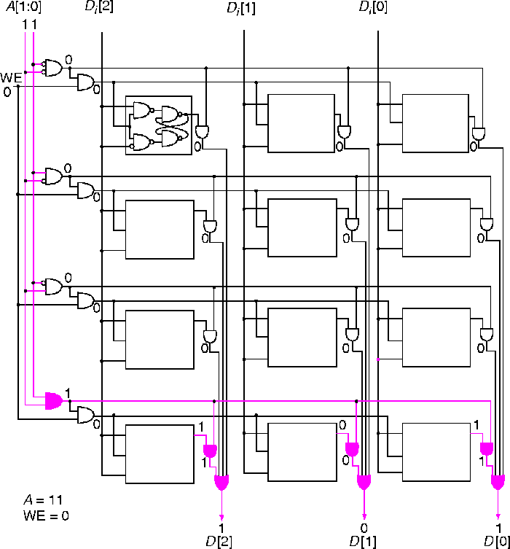
Reading 3 bits from a 4 address memory

Slide 34
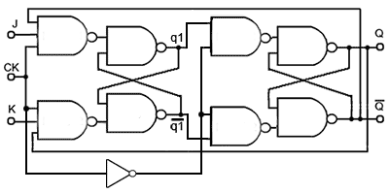
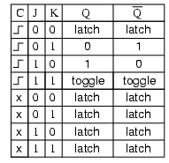
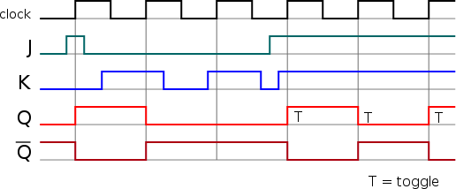
Counter = Adder with Memory (Flip-Flop)

Slide 35
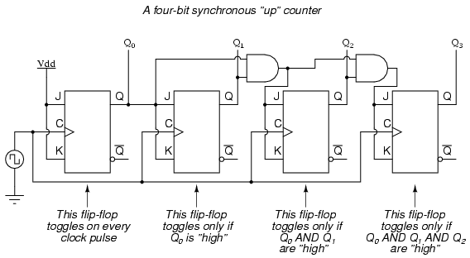
Counter = Adder with Memory

Slide 36
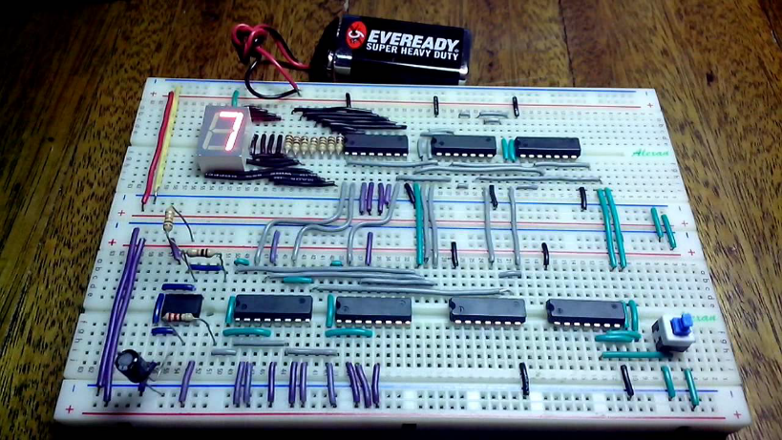
Counter = Adder with Memory

Slide 37
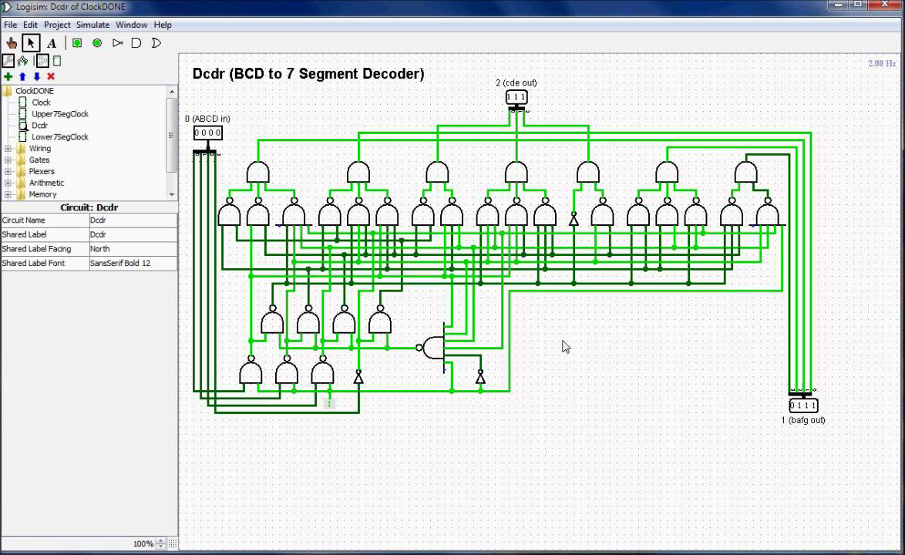
http://www.cburch.com/logisim

Slide 38
Now You Know…
Digital Logic Circuits
All computers are made from chains of simple logic gates
NAND and NOR gates are universal → they can make all other gates!
How a computer performs arithmetic = full adders
Subtraction is just addition with inverted logic
Multiplication is just repeated addition
Division is just repeated subtraction
How a computer stores numbers in memory = flip-flops
Four gates make a bit, eight bits make up a byte
Imagine how many gates are in your 32GB smartphone!

